Slide 1


Department of Electrical and Electronics Engineering
Third Reveiw
Capstone project PIP2001
Inter- disciplinary project
ROBOTICS TECHNOLOGY FOR PHYSICALLY ABLED WARRIORS
MIND CONTROLLED WHEELCHAIR
Under the guidance of
Mr. Sunil Kumar. A. V
Dept. Electrical and Electronics Engineering
School of Engineering
Under the guidance of
Ms. Poornima Selvaraj
Assistant Professor
Dept. of Computer Science Engineering
School of CSE/ISE

Slide 2
Group:
Sl. No | Name | Register number | Department | Student mail Id
01 | Manjunath A C | 20211CAI0124 | CSE | MANJUNATH.20211CAI0124@presidencyuniversity.in
02 | Prajwal Kanthan | 20211CAI0075 | CSE | PRAJWAL.20211CAI0075@presidencyuniversity.in

Slide 3
Content:
Introduction to Robotics Technology
Problem Statement
Analysis of the Problem
Block diagram
Key components
Objectives
Methodology

Slide 4

Introduction to Robotics technology
Robots are machines designed to carry out tasks automatically or under human control. They can perform a wide range of actions, from simple repetitive jobs to complex tasks that require decision-making.
Robots are designed to assist humans by doing jobs faster, more accurately, or in places that might be dangerous for people. As robotics technology grows, these machines are becoming more common in everyday life, helping make tasks easier and more efficient.

Slide 5
Problem statement:
 For many individuals with severe physical disabilities, everyday mobility can be a significant challenge. Traditional wheelchairs often require the use of hands or feet, which can be impossible for those with limited motor function. This can lead to a loss of independence and a reliance on caregivers for even the simplest tasks, affecting their quality of life.

Slide 6
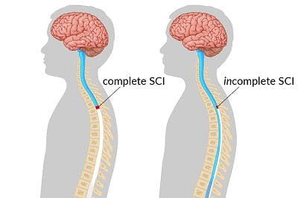
Analysis of the Problem:
Complexity in Operating Existing Devices:-
Most available wheelchair technologies still demand some degree of motor control (joystick or head movement), which is impossible for individuals who have quadriplegia (the cause of quadriplegia is an injury to the spinal cord in your neck) or are otherwise completely paralyzed. These users cannot engage in any form of manual input, making current assistive devices inaccessible.

Slide 7
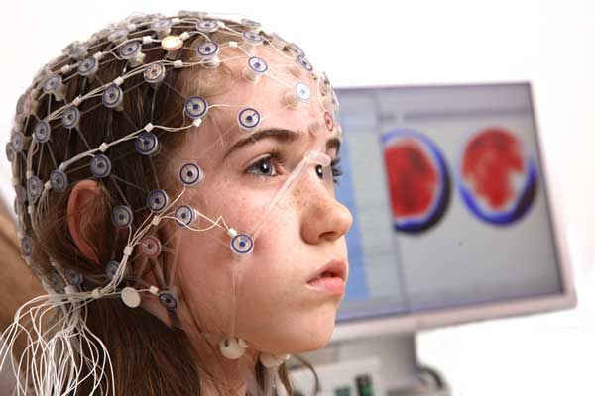
EEG-Based Control as a Potential Solution:-
By using Electroencephalogram (EEG) signals to control a wheelchair, the system circumvents the need for any physical or muscle-based inputs.
Brain activity, such as attention and meditation levels or eye blinks, can trigger movement, providing a feasible alternative to manual controls. However, controlling EEG signals poses its own challenges, such as noise and inconsistency in meditation and attention levels.

Slide 8
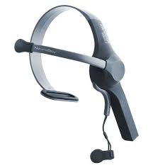
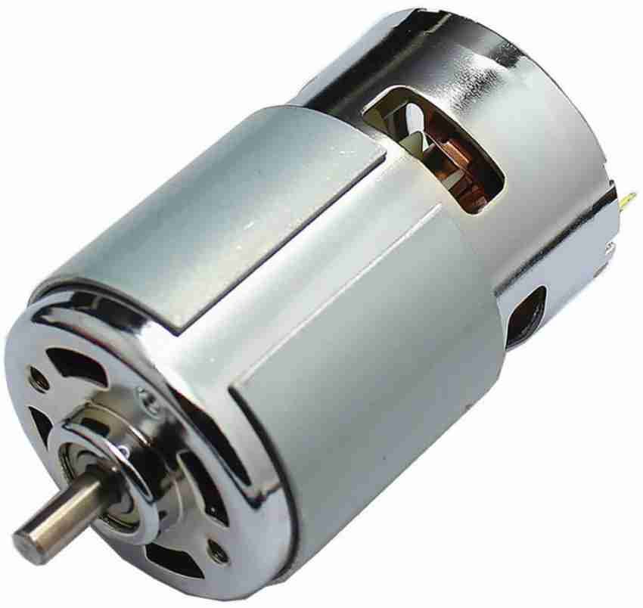

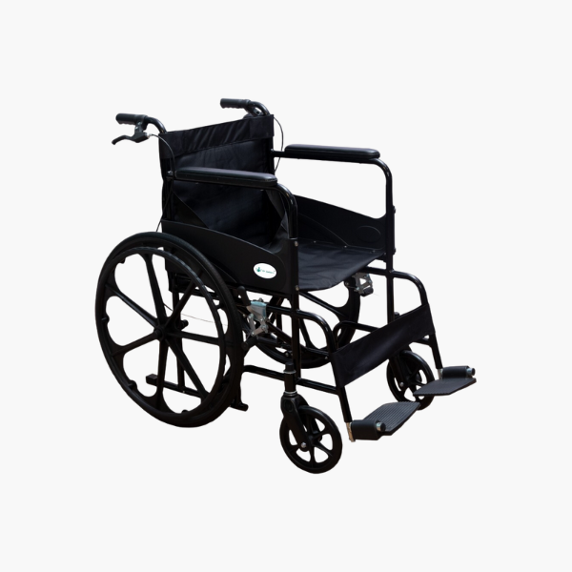
Block diagram:
Micro Controller
Signal analyser
Decoder
EEG Headset
Control System
Brain Computer Interface
Motor Drive
Sensor
Feedback
Wheel Chair

Slide 9
Key components:
Brain sensor:-
The project aims to provide mobility for completely paralyzed patients using EEG (Electroencephalogram) signals to operate a wheelchair, controlled through brain-computer interface (BCI) technology. It uses eye-blinking, meditation, and attention levels for navigation in six directions: forward, backward, left, right, start, and stop.
System Design:-
Hardware:-
Neuro Sky headset (for EEG signal collection)
Arduino Uno (for processing)
HC-05 Bluetooth module (for wireless communication)
L298N motor driver
ESP8266 Wi-Fi module for messaging in emergencies.
Software:-
Arduino IDE with embedded C programming.
Workflow:-
The EEG headset captures brain signals and transmits them via Bluetooth to an Arduino board, which controls the wheelchair's movement. An IR sensor detects obstacles, and a vibration sensor alerts caregivers via a Wi-Fi module if a collision occurs.

Slide 10
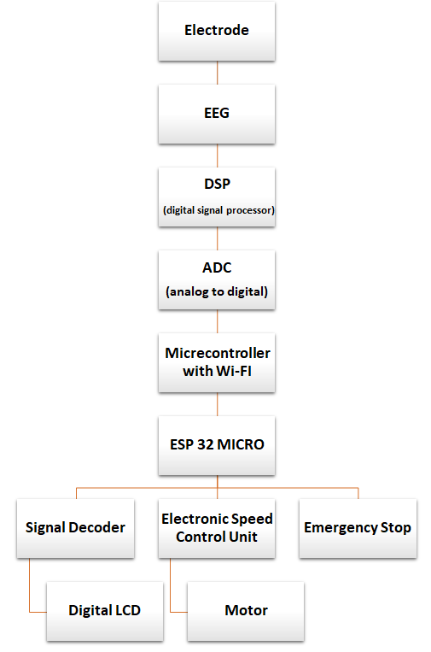

Slide 11
Electrode
DSP
(digital signal processor)
EEG
ADC
(analog to digital)
Micrecontroller with Wi-FI
ESP 32 MICRO
Signal Decoder
Emergency Stop
Electronic Speed Control Unit
Motor
Digital LCD

Slide 12

Objective:
1). Enhanced Mobility: To allow users to control a wheelchair through brain computer interface (BCI) technology, bypassing physical limitations and enabling them to move independently.
2). Improved Quality of Life:
By restoring a sense of autonomy and reducing dependence on caretakers, the wheelchair enhances the user's day-to-day quality of life.
3). Accessibility: Providing an alternative to traditional manual or joystick-controlled wheelchairs for people with conditions such as spinal cord injuries, ALS (amyotrophic lateral sclerosis), or cerebral palsy.

Slide 13
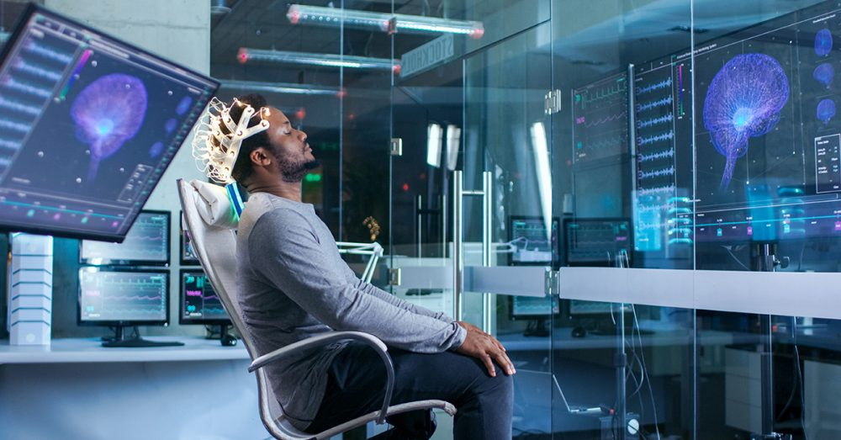
Methodology:
The methodology behind a mind-controlled wheelchair involves several key steps that combine neuroscience, engineering, and computer science to translate a user's thoughts into wheelchair movement.
Here's a simplified breakdown of the process:
Brain-Computer Interface (BCI) Setup:
Electrode Placement: Electrodes are placed on the scalp or implanted in the brain (for more advanced setups) to detect brainwave activity using EEG (electroencephalography).
Signal Acquisition: The electrodes capture electrical signals from the brain that correspond to the user’s intentions, such as the desire to move forward or turn.

Slide 14
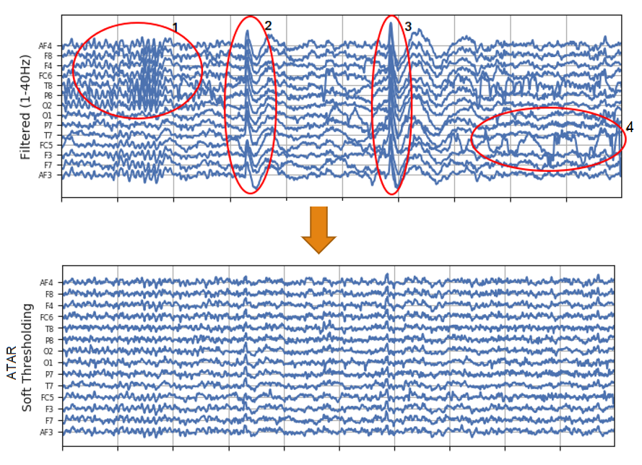

Signal Processing:
Pre-processing: The raw EEG data often contains noise (irrelevant signals), so it needs to be cleaned up. Techniques like filtering and removal of unwanted signals are used to improve the quality of the brain signals.
Feature Extraction: The system identifies specific patterns or features in the brain signals associated with different thoughts or mental commands, like focusing on an object or thinking of a particular action.
Classification: A machine learning algorithm is trained to classify the brain signal patterns into corresponding wheelchair commands (e.g., move forward, turn left, stop).

Slide 15

User Intent Mapping:
Calibration and Training: The system is calibrated to each individual user. The user is typically asked to perform mental tasks (like imagining hand movements or focusing on objects), which the system learns to interpret as specific movement commands for the wheelchair.
Real-Time Feedback: The system provides real-time feedback to the user, allowing them to adjust their thought patterns to refine control over the wheelchair.

Slide 16
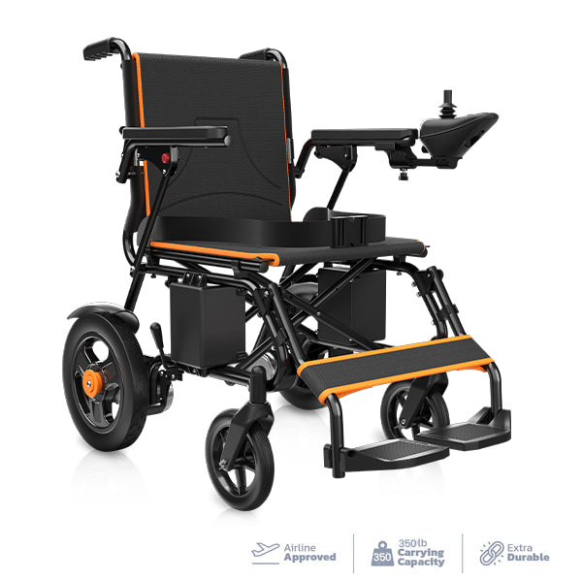
Wheelchair Control:
Signal Transmission: Once the brain signals are processed and classified, they are transmitted to the wheelchair's control system.
Motor Control: The wheel chair's motors respond to these signals, executing the appropriate action (e.g., moving forward, turning left, etc.). The system ensures smooth and safe navigation, incorporating safety mechanisms like obstacle detection.

Slide 17
Continuous Learning and Adaptation:
User-Specific Adaptation: Over time, the system learns from the user’s brain activity and fine-tunes its responses to better match their intent, leading to smoother and more intuitive control.
Error Handling and Correction: In case of incorrect movements, the system can have built-in mechanisms for error detection and correction, allowing the user to stop or adjust commands.
Testing and Validation:
Lab-Based Testing: The system undergoes rigorous testing in controlled environments where it is evaluated for accuracy, responsiveness, and safety.
Real-World Trials: The wheel chair is tested in real-world scenarios, often involving people with disabilities and make adjustments based on feedback.

Slide 18

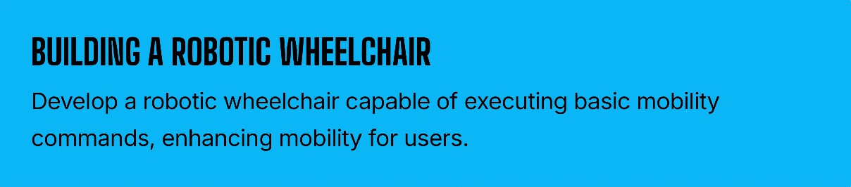

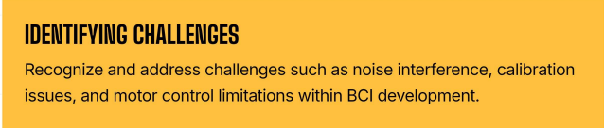
Stage 1- Planning and Conceptualization
UNDERSTANRNGBRA222INWAØEØAT
I

Slide 19
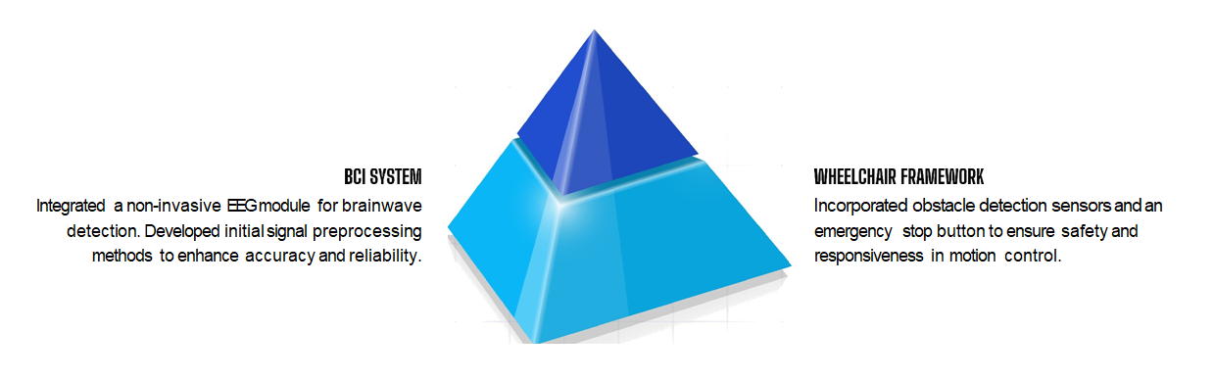
Stage 2-System Design And Development

Slide 20
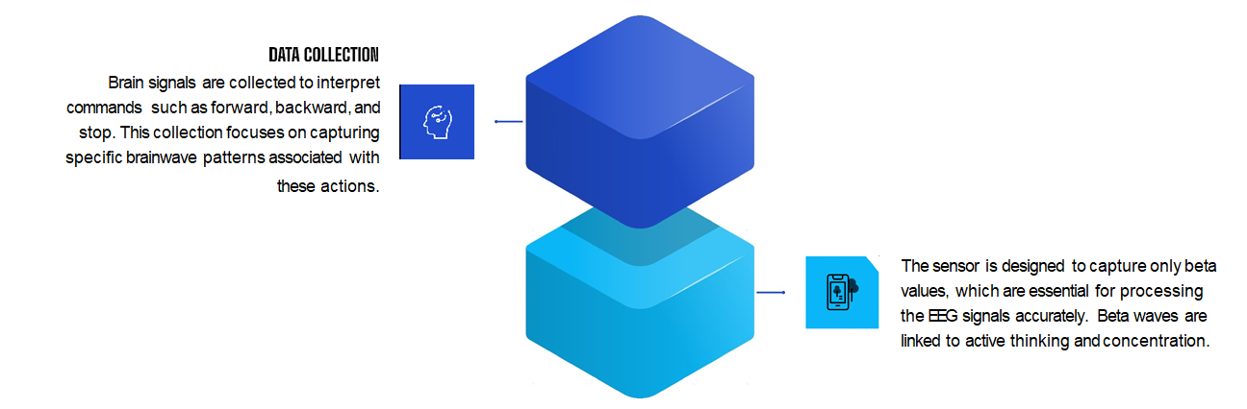
Stage 3- EEG Signal Processing

Slide 21
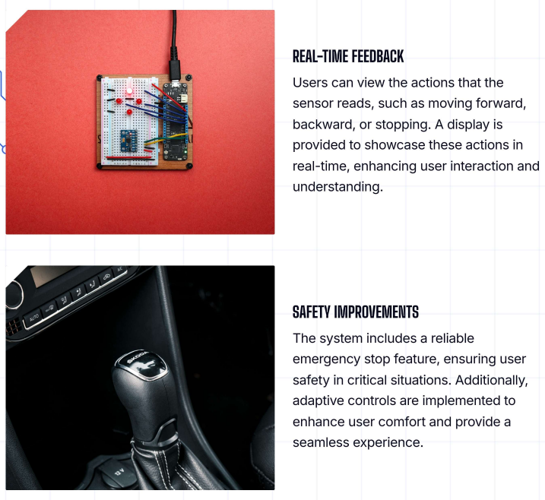

Slide 22
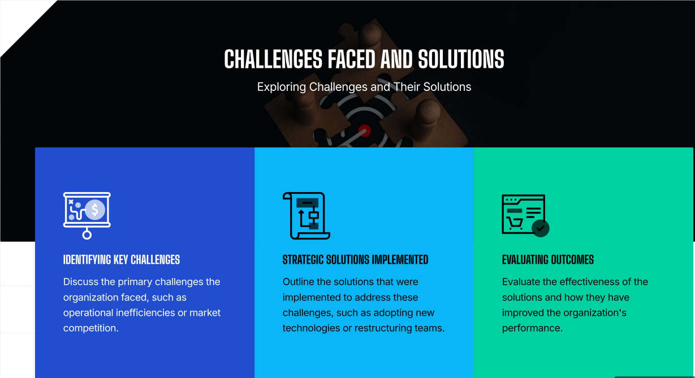

Slide 23
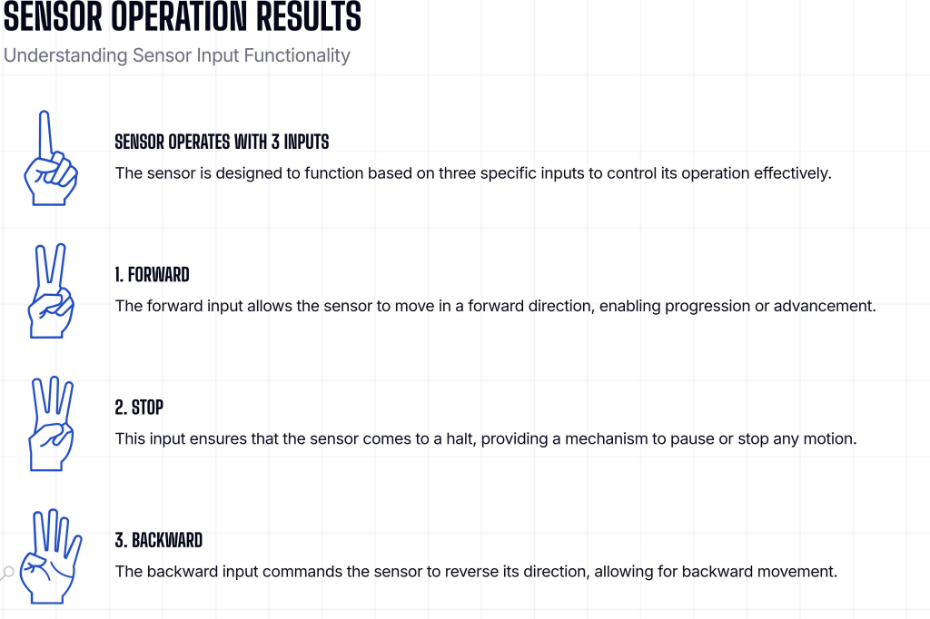

Slide 24


